Slide 1
Are stable coins better coins?
Presented by Ruanjia (Katerina) Liu
2nd PhD student in Accounting Information System
Rutgers Business School

Slide 2
Stable Coin
Stable coin aims to overcome price fluctuation and boost cryptocurrency acceptance. There are four types:
1. fiat collateralized
rely on fiat currencies such as the U.S. dollar to maintain their value
are backed at a 1:1 ratio: for one stable coin, there is one unit of currency (like a dollar) as the reserve
2. commodity-collateralized stable coins: are backed by interchangeable assets, such as metals and oil
3. crypto collateralized:
are backed by other cryptocurrencies such as Ether (ETH)
are much more decentralized and over-collateralized to reduce price volatility risks (1:3 ratio)

Slide 3
Stable Coin (continued)
4. non-collateralized stable coins: use an algorithmically governed approach to control the coin supply and demand
The report (“An overview of the current state of stablecoins ”) from the team at BlockData states:
95 percent of the active stable coins are asset-backed such as the US dollar or gold
Fiat -based stablecoins have a higher chance of survival than commodity-backed stablecoins
50 percent of active stablecoins are developed on the Ethereum network. Ethereum network is the most common choice of blockchain protocols

Slide 4
Stable coin- Tether
Tether (USDT), created in 2012, is the 8th stable coin by market cap
Criticism of Tether
fails to provide sufficient evidence of adequate fiat reserves
shares the same chief executive officer with the Bitfinex exchange( its sister company )
lacks long-term banking relationships
Cryptocurrency exchanges are forced to get involve with shadowy middlemen of the crypto industry because of the lack of access to the legitimate financial system

Slide 5
Recent Tether Scandal
The New York Attorney General sued Bitfinex for fraud in April 2019
Crypto Capital, the intermediary for Bitfinex exchange, said that $850 million in customer funds could not be returned
How the Bitfinex react
Borrowed from its sister company, the stablecoin issuer Tether to cover the $850 million hole
Claimed that these $850 million amounts are not lost but had been seized and safeguarded by the government authorities in Portugal, Poland and the U.S
BitFinex, operating both Bitfinex and Tether, plans to issue initial exchange offering of $1 billion worth of the Tether. It plans to buy back these coins after the recovery of $850 million

Slide 6
Facebook’s Libra Project
Libra’s mission is to enable a simple global currency and financial infrastructure (more efficient payments system) that empowers billions of people
Of 7 billion people 1.7 billion are unbanked. That is 31% of the global population
For those who do have access:
Transfers are slow. A typical cross-broader payment takes three to five working days to complete
Costs are high. On average, it costs 7% to send money internationally
Costs are higher for the poor. On average, the unbanked pay $4 higher fees/month for cash access

Slide 7
Facebook’s Libra Project
The world still runs on cash. 85% of global transactions use cash
Cash can be hard to move around and easy to steal. U.S. retail businesses lose about $40 billion annually due to the theft of cash
Thus, access to digital financial services can have a BIG impact
Add $3.7 trillion to developing economies, and create 95 million new jobs
Improve people’s income earning potential by 20% and reduce extreme poverty by 22%

Slide 8
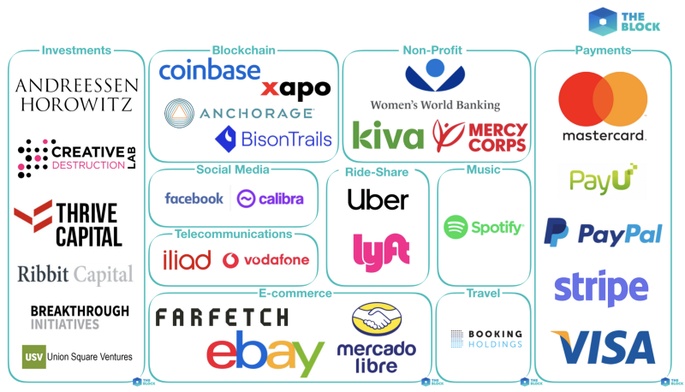
Facebook’s Libra Project
Libra cryptocurrency: a stablecoin set to launch in 2020 which will initially let users transfer money between Facebook’s Messenger and WhatsApp applications
Libra coins will be stored on the Calibra wallet, a separate company to Facebook
Users financial data is kept separate from their personal data on Facebook
The Libra Association is an independent, not-for-profit membership organization. The Libra Association is made up of a group of diverse organizations from around the world.

Slide 9
Libra reserve
Main purpose: support stability and value preservation
Each coin is backed with a set of stable and liquid assets
Gives intrinsic value on day one and helps protect against the speculative swings of other cryptocurrencies
Link reserve to the value of the USD or GBP (Great Britain Pound) but to a basket of currencies of the most popular fiat currencies including the euro and yen
Even if one currency loses it’s value, Libra will remain stable
Users can have confidence that they will be able to sell any Libra coin at or close to the value of the reserve at any time

Slide 10
How the Reserve Change Over Time
Baseline: The reserve will remain fully backed across time
The association may occasionally change the composition of the basket in response to significant changes in market conditions (e.g., to respond to an economic crisis in certain regions)
The size of the reserve is determined by the size of the balances that users are holding in Libra
The Libra ecosystem grow or shrink with demand. When the value of backed assets increase, new minting of coins occur
Discourages “runs on the bank”: a coin is only fractionally backed, so users want to get their backing out before others do

Slide 11
Setbacks and Public Pressure
6 of 28 Association members drop out: Stripe, MasterCard, VISA, PayPal, eBay, and Mercado Pago
The Secretary of the United States Treasury, Steven Mnuchin, said that the government would be taking action if Libra project fails to meet the anti-money laundering standards (AML)
Ashley Alder, Chair of the IOSCO Board, argued that since ‘stablecoins’ possess certain features of typical securities, they should subject to significant international and public scrutiny

Slide 12
Conclusion
BTC markets are dominated by Tether with greater liquidity represented by lower spreads and higher volumes than other stablecoins
The success of Tether offers proves that market participants prefer stability over decentralization in the short term
Stablecoins are useful only when they are stable and implemented with stringent audits
Libra has the potential to replace all current stablecoins given the large userbase of Facebook and the reach of the other members of the Libra Association

Slide 13
Conclusion
Unclear future
Facebook could hold too much power
the larger goal of Libra is to transform the global economy
Facebook had issues with data privacy and Libra could ultimately threaten the power of the US dollar and other fiat currencies
The breakdown of the system for a short time could cause the world distress
The successful launch of Libra will have huge impact on cryptocurrency markets

Slide 14
Q&A

